Slide 1
Selecting Movie Scripts the Data Science Way
W201-5 Final Project
Natarajan Shankar, Varadarajan Srinivasan, Leslie Teo, Qian Yu

Slide 2

Motivation
Script is the heart of a movie
Script selection is a critical step in movie production
Data Science is mainly used in market research and promotion strategy
There is no good technology available to analyze scripts
Studios rely upon sequels. Aren’t we just tired of sequesl?

Slide 3

Our Mission
Develop an movie script analyzing tool to:
Improve script selection efficiency
Predict audience likeability and box office potential

Slide 4
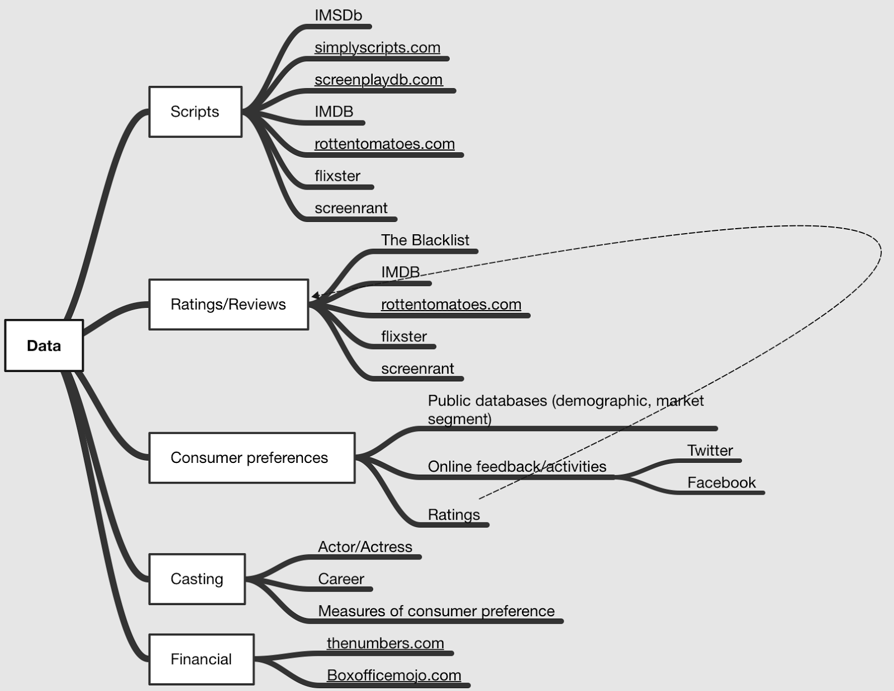
Data Source and Success Metric
Confusion Matrix
Conversion Rate
Avg Movie rating
Avg Box Office Potential
Data Source
Benchmarking
Performance Metric

Slide 5





Algorithm and Methodology
new
Attributes
Linear
Classifier
Clustering
Analysis
genre
theme
location
Past
scripts
ranking
Adjusted
Ranking
Sentiment
Classifier

Slide 6




Risk Factors
Fallacy:
Overestimation
accuracy of algorithm
Art vs. Commerce: does the tool favor commercial success?
Interpretation Bias:
Does “sorry” really mean “sorry”?
Fairness:
Writers may consider the tool again creativity

Slide 7

Future
Enhance with additional wide spectrum of less known scripts
Amplify target segment and sub-segments of genres
Provide feedback to writers
Measure plot direction and dialog quality
Analysis of other elements of movie production

Slide 8
Q & A

